Slide 1


Bullied and Punished:
Using Youth Narrative Mapping to Rethink Entrenched Approaches
Sarah Schriber, JD
Prevent School Violence Illinois
Dr. Stacey S. Horn
University of Illinois at Chicago
International Bullying Prevention Association Conference
Chicago, Illinois
November 8, 2019

Slide 2
Welcome and Introductions
Who we are
Who you are and
why you are here?
* What is your name?
* What are your pronouns (e.g., they, them; she, her; he, him; ze, zir)
* Where are you from?
* What is your role? How do you engage with young people around issues of bullying and discipline?
* What drew you to this session?
* What do you hope to learn here/leave with?

Slide 3
Overview of the Session
Overview of our study
Overview of the youth narrative mapping methodology
Applications of youth narrative mapping to your own work

Slide 4
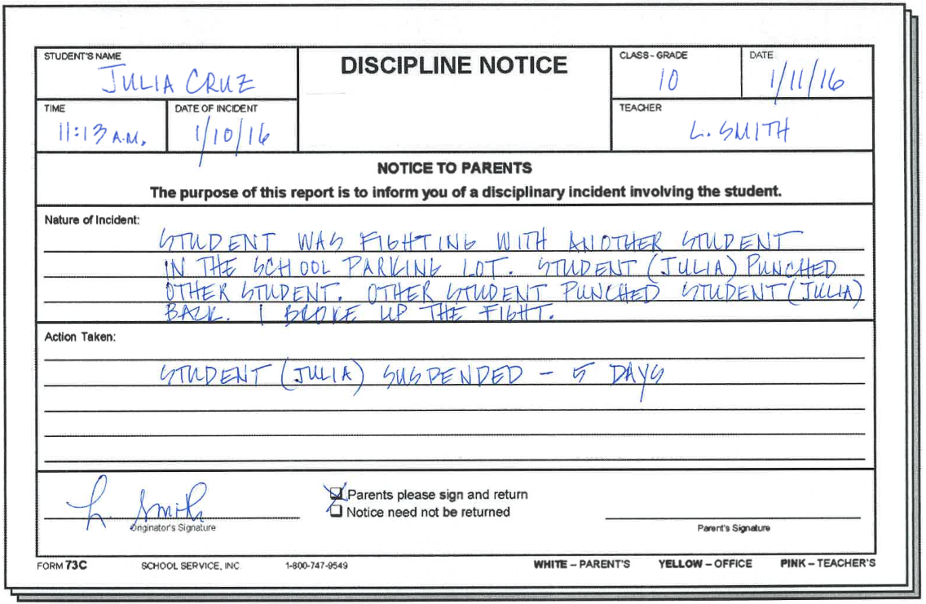
Security pulled me out of the bathroom by my arm and drag me to the principal’s office. They told me that that was my last straw and they were going to kick me out. And I begged them to stay. And that I was gunna go to class and you know, but the principal just looked at me and said “just take her out!” and so they took me out.
In the hallways, the girl would call me a “fag” and I just kept walking.
I had seen so many people getting bullied cuz they’re lesbian or gay or transsexual so it scared me. So I was like man I really hate myself.
She started writing on Facebook and stuff saying, you know, “don’t talk to her cuz she’s a lesbian” and “she’s gunna try to have sex with you.” And she’s like “oh she’s nasty, don’t talk to her!” you know, some stupid stuff.
I wasn’t proud of like who I am like I didn’t wanna admit it, and just a fear of you know getting denied from my mother.
They caught me hiding in the bathroom.
I began skipping a lot of classes.

Slide 5
Youth Voices Matter
20 young people (ages 16-21) from 2 queer youth advocacy organizations in the Chicago area
Self-identification across a range of identities
  Sexual orientations (e.g., queer, gay, lesbian, omnisexual, heteromantic homosexual)
  Gender identities (e.g., gender queer, transgender, androgynous, female, male)
  Racial/Ethnic identities (e.g., Latino, Black, Colored, European American)
Interviews
  Lasted between 20-50 minutes
  Protocol included questions in a broad range of categories (e.g., family; housing situation; employment; bullying victimization, bullying perpetration; disciplinary experiences; school culture; experience with juvenile justice)
Notes:
We conducted in-depth, one-on-one interviews in private or semi-private settings with 20 young people who met our age criterion (ages 16-21) and who identified their sexual orientations and gender identities in a variety of ways (e.g., queer, gender queer, transgender, androgynous, gay, lesbian, omnisexual; Latino, Black, Colored, European American). We recruited participants from two queer youth advocacy organizations in the Chicago area and interviewed, on a first come, first-served basis, a group of young people who volunteered to participate and share their experiences with school discipline, school bullying, and the criminal legal system. Interviews lasted approximately 20 to 50 minutes each and all participants provided assent/consent prior to the interviews We developed our interview protocol using an existing, semi-structured protocol (Irvine, 2010), which we piloted and refined.
The protocol included questions in the following areas:
self-identification of demographics
family structure
living/housing situation
employment/sources of income
school history
school context
experiences with bullying victimization and perpetration
experiences with school discipline
experiences with the juvenile justice system and
recommendations for educators.

Slide 6
Bullying to Discipline Analyses
Coding, Analysis and Mapping
  Recorded and transcribed each interview
  Identified and highlighted bullying incidents in each transcript
  For each individual incident, created a visual map of experiences that occurred prior to the incident, the bullying incident itself, and what followed
  Used maps to identify the pathways from bullying to punishment, coding the following items: bullying incident, youth response, youth report (if any), adult response (if any), punishment/discipline, impact (e.g., school engagement, mental health)
Notes:
We conducted in-depth, one-on-one interviews in private or semi-private settings with 20 young people who met our age criterion (ages 16-21) and who identified their sexual orientations and gender identities in a variety of ways (e.g., queer, gender queer, transgender, androgynous, gay, lesbian, omnisexual; Latino, Black, Colored, European American). We recruited participants from two queer youth advocacy organizations in the Chicago area and interviewed, on a first come, first-served basis, a group of young people who volunteered to participate and share their experiences with school discipline, school bullying, and the criminal legal system. Interviews lasted approximately 20 to 50 minutes each and all participants provided assent/consent prior to the interviews We developed our interview protocol using an existing, semi-structured protocol (Irvine, 2010), which we piloted and refined.
The protocol included questions in the following areas:
self-identification of demographics
family structure
living/housing situation
employment/sources of income
school history
school context
experiences with bullying victimization and perpetration
experiences with school discipline
experiences with the juvenile justice system and
recommendations for educators.

Slide 7
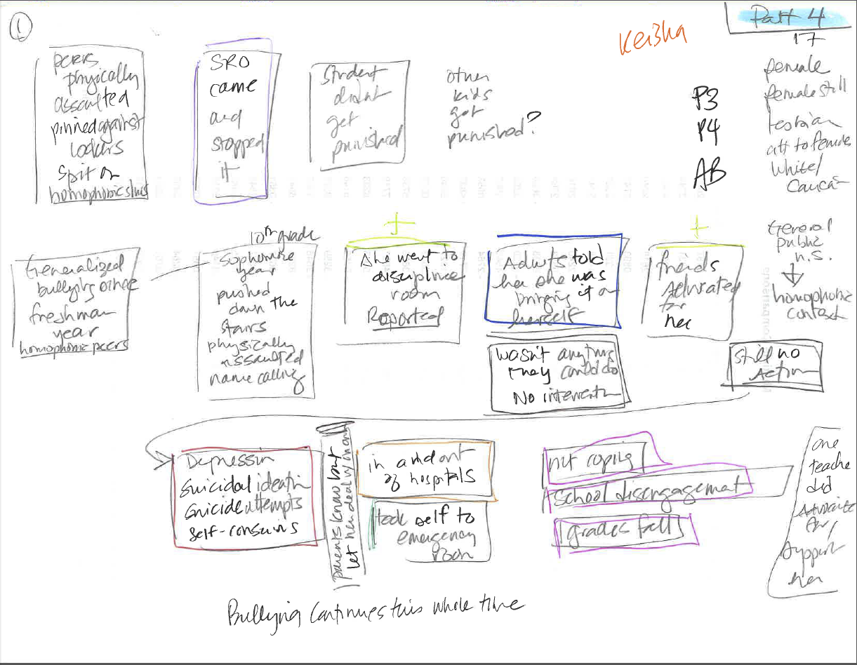
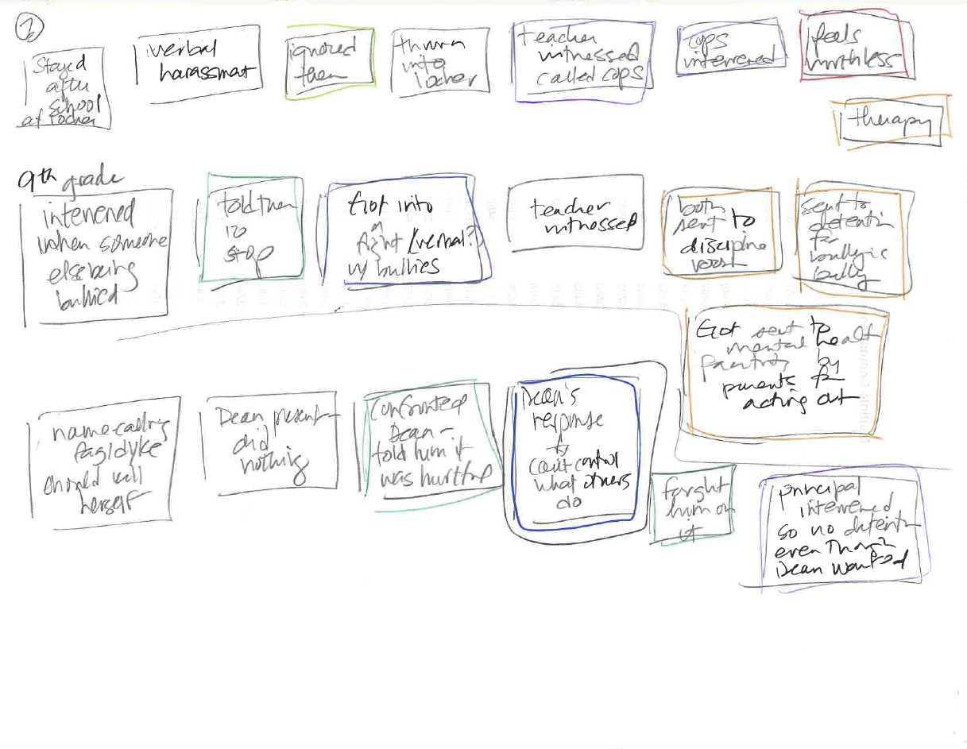
Mapping Keisha’s B2D Pathways

Slide 8
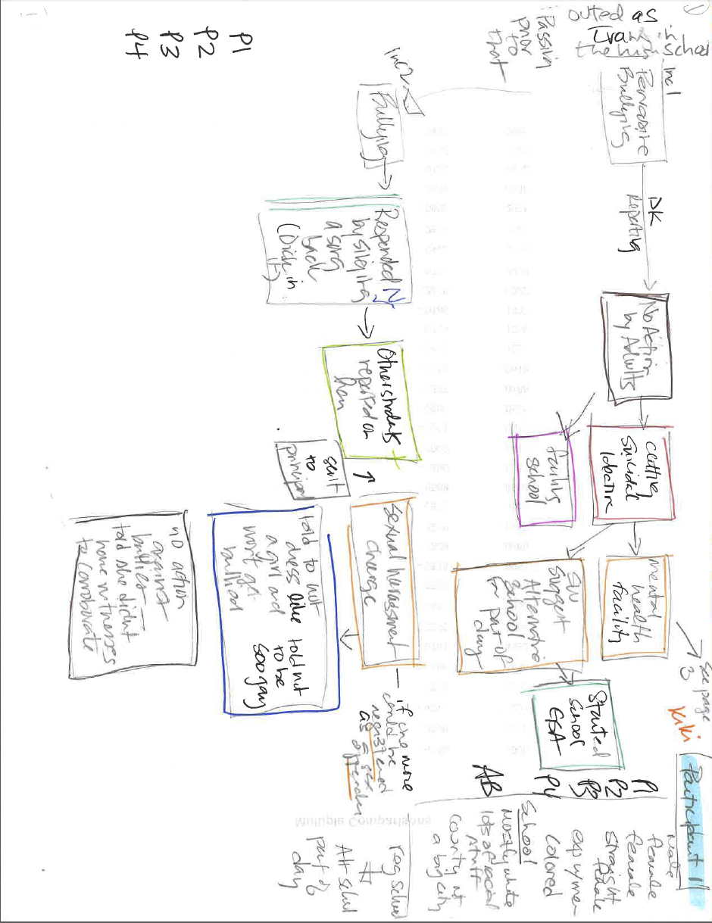
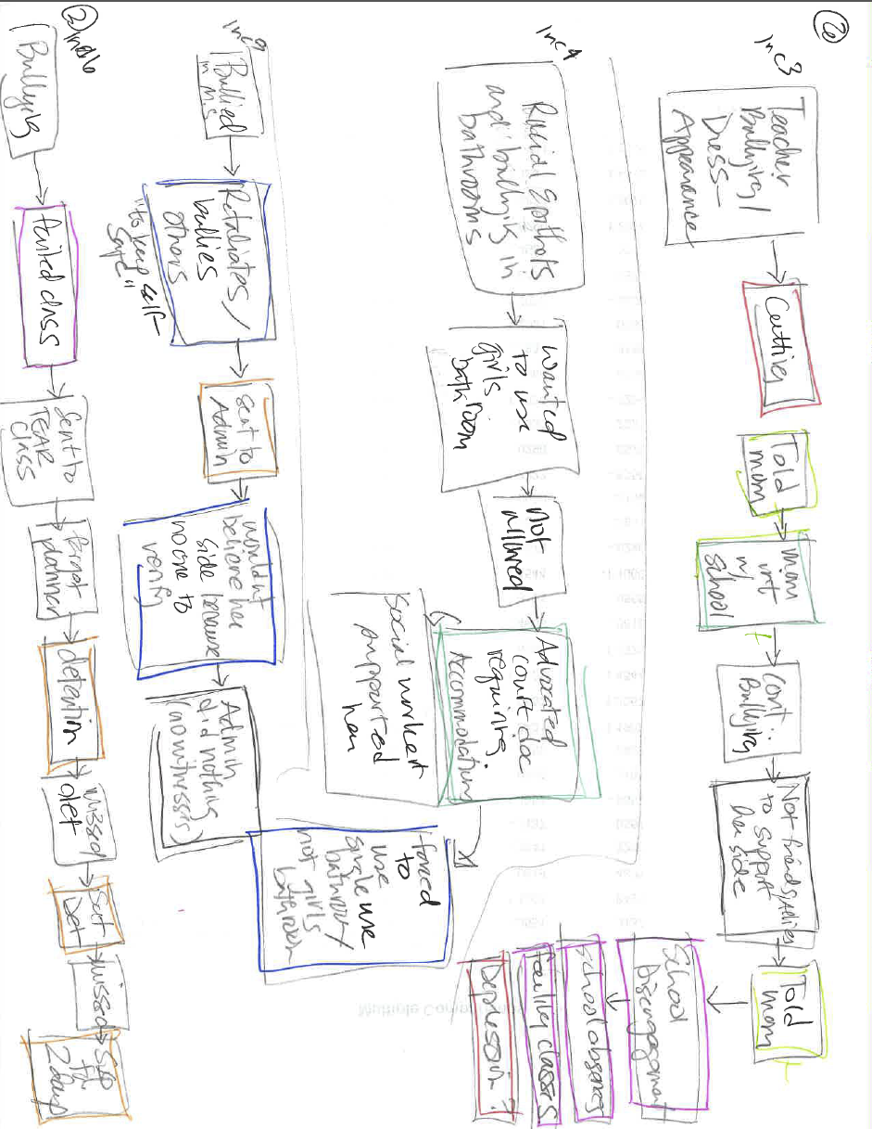
Mapping Kiki’s B2D Pathways

Slide 9
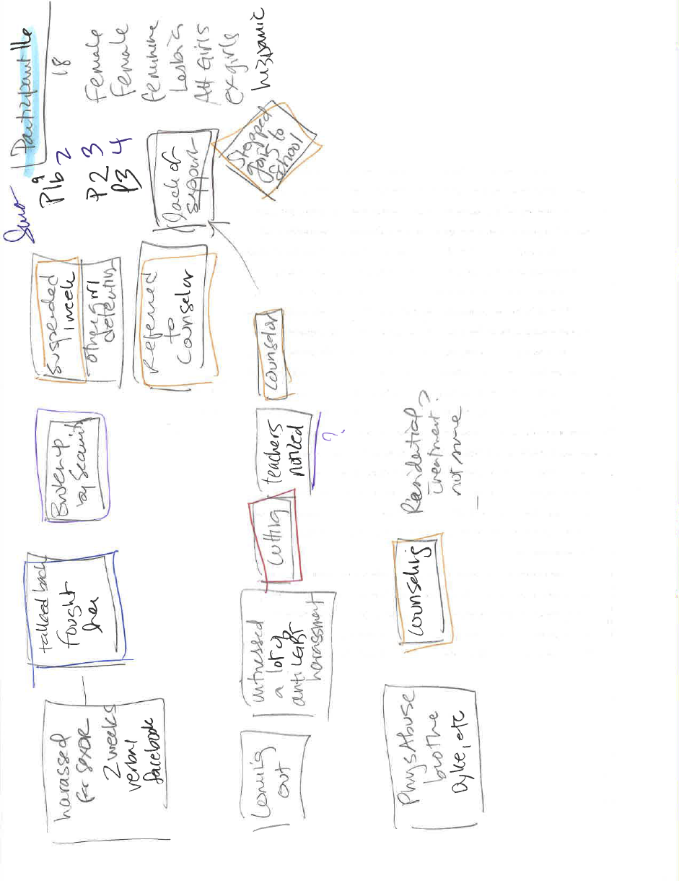
Mapping Julia’s B2D Pathways

Slide 10
Five Pathways: Bullying to Discipline
Victimization→ Effective adult response→ Developmental discipline
Victimization→ Student report/self-advocacy→ Ineffective/inappropriate adult response→ Informal punishment
Victimization→ Ineffective adult response/no adult response → Participant’s direct response → Punitive discipline
Victimization→ Ineffective adult response/no adult response→ Escape from the situation→ Punitive discipline
Victimization→ Ineffective adult response/no adult response→ Correlated mental health issues → Informal punishment
Notes:
After this, go back to the overarching takeaway, which is that:
PRESUPPOSITIONS:
Bullying/harassment and punitive/exclusionary discipline cause harm and result in adverse outcomes for students
We want to decrease bias-based bullying and bullying/harassment generally and want to increase developmental discipline
Student narrative mapping provides us with rich details about student experiences that we can use to reduce bullying and punitive discipline and increase developmental discipline
Then, how do we do this in real time?

Slide 11
Forms of Discipline/Punishment
Developmental discipline (e.g., supported conversations)
Formal, punitive discipline (e.g., detention, suspension)
Informal punishment (e.g., victim blaming; transfer to alternative schools, programs, or different class sections; commitment to residential treatment facilities)
Notes:
We identified three forms of discipline/punishment students experienced that related directly to their bullying experiences in school.
Focused on harm caused to students as opposed to a discrete incident, behavioral moment

Slide 12
Pervasive and Insidious SOGI-Related Bullying
[W]hen I was in the locker room, kids would be telling me, “oh well do you like…what are you? Why are you in here? You should be in the girls’ locker room! Joseph (Non-Binary, Gay, age 21)
Because they always called me “faggot” as I was walking up and down the hall and [said] “he’ll do anything. He’ll suck dick. And he’s a male prostitute for the gays. Dylan (Male, Gay, Hispanic, age 17)
I was getting you know bullied very bad like people were throwing things at me you know they were calling me names. Kiki (Trans female, Straight, Colored, age 16)
[T]his dude called me a “dyke” like twice and apparently he was like “just kidding” or whatever, but I don’t even know what that means. Kate (GNC, omnisexual, age 16)
If you come out as anything, gay, lesbian, you are automatically subjected to verbal abuse from anyone and everyone. Farrah (Straight, Female, GNC, White, age 16)
Notes:
100% of student participants described experiencing a pervasive culture of SOGI-related bullying

Slide 13
Ineffective adult responses to bullying
Ignore
Downplay and dismiss
Claim there is not enough “evidence”
Place responsibility with the student experiencing victimization
Threaten the student with formal or informal punishment, or criminal sanction
“Out” the student or threaten to “out” the student to their parents
Change the schedule of student experiencing bullying
Change student experiencing bullying to alternative school

Slide 14
Adults Bullying Youth
40% of student participants described being bullied by adults at schools.
  Verbal harassment
  Victim blaming
  Misgendering
  Ostracism
  Threats
  Sexual harassment
Notes:
40% - 6/15

Slide 15
Unsupported navigation of hostile school cultures
Isolate
Skip class/stay home from school
Intentionally get detention
Drop out
Verbal aggression
Physical aggression

Slide 16
Bullied and Punished
Pervasive and insidious cultures of SOGI-related bullying +
Bullying Incident +
Ineffective adult responses to bullying +
Unsupported navigation of hostile school climates =
PUNISHMENT

Slide 17
Application of Mapping to Your Work
General reactions/thoughts to the overall study/mapping?
What is this bringing up for you in relation to discipline systems that you engage with in your work?
Notes:
(interview protocol questions; have students create maps in real time using current incident and building out the context
Tier 1 level (e.g., teaching, community building, prevention)
Tier 2 level (e.g., discipline)
Tier 3 level (e.g., mental health referral)
Do this with "victims" and "perpetrators"

Slide 18
Applications: Small Groups
How might we use mapping with students?
  Preventatively?
  As a response to an incident?
What systemic obstacles are in the way of doing this?
How could we adapt the system to collect more and better information?
  Discipline systems?
  Other systems?

Slide 19
Questions?
Sarah Schriber, sarah@psvillinois.org
Stacey Horn, sshorn@uic.edu

Slide 20
Thank You
Funder (University of Indiana, Equity Project, Discipline Disparities Collaborative)
Youth Voices Matter Research Team
Brave Youth Participants
YOU!

