Slide 1

WELCOME, SUPERHEROES
EDUCATOR EDITION

Slide 2
hi!
I am Susan Raisch.
Notes:
I was working at ABC News when Columbine happened. On that day I was working from home and my high school son at that time and I watched as a bloodied boy -- I now know his name is Patrick Ireland -- was dangling from a broken window trying to escape. Although we now know at its core was mental illness, my son and his friends thought it was bullying. In an effort to understand this issue, II began by going to the IBPA conference and then travelling the country, talking to experts, researchers, parents, schools and kids. My 3 takeaways: starts early -- as early as 4 years old, perhaps younger, it’s messy and complicated like a tangled ball. But like any tangled ball there is hope when we take out one string at a time. Because the behavior starts young, who do we best engage parents and teachers of young children.

Slide 3
Why are we here?
Notes:
Just take a moment to think about why you’re here. Why you chose the profession you did. Why did you come to this conference. Doesn’t have to be shared but I’ll share why I’m here.
The role of the Go-To Trusted adult -- you and us -- cannot be overestimated. My focus is alway Why and How do we get the great information we are hearing at the conference in the hands of parents and teachers in order to help make that home and school foundation strong and seamless.

Slide 4
“
Every child is just one caring adult away from becoming a success story.
Josh Shipp
Youth / Teen Expert

Slide 5
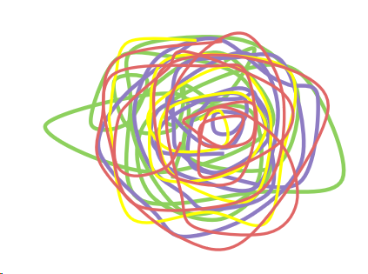
1/3
Notes:
What is bullying? We describe it as Repeated intentional behavior to make another person feel bad. It includes physical, emotional, mental, relational, exclusionary behavior. But in the words of Brene Brown, in the absence of love and belonging, there is suffering. That’s the last thing we want for our children. Either to cause those feelings or to experience them. And although most people talk about it in relation to middle and high school,
Definition; brene brown; quick exercise

Slide 6
THE SCARY NUMBERS
SCARY
64%
80%

Slide 7
TELL A TRUSTED ADULT.
MOST COMMON PIECE OF EXPERT ADVICE
Notes:
That’s us. How important is it? It is the #1 most consistent piece of advice experts give to kids. What does trust in this respect mean? It means safety and skills.
The skill is to help young children stretch to become their best selves academically, socially, emotionally. Sometimes it’s Stepping up when needed, sometimes stepping back to promote life-long skills like resilience…but always, always walking beside them.

Slide 8
Expert Tips for Teachers
C: Caring for the student beyond academics
U: Understanding the Root Cause
R: Reacting Appropriately
E: Engaging with Compassion
Notes:
That’s why you get that stunning trophy that’s in front of you. You are probably already doing this. What’s hard is that often you’re not thanked. So far the kids you have already helped, thank you. I have an idea on how to use this trophy next semester which I’ll mention later.

Slide 9
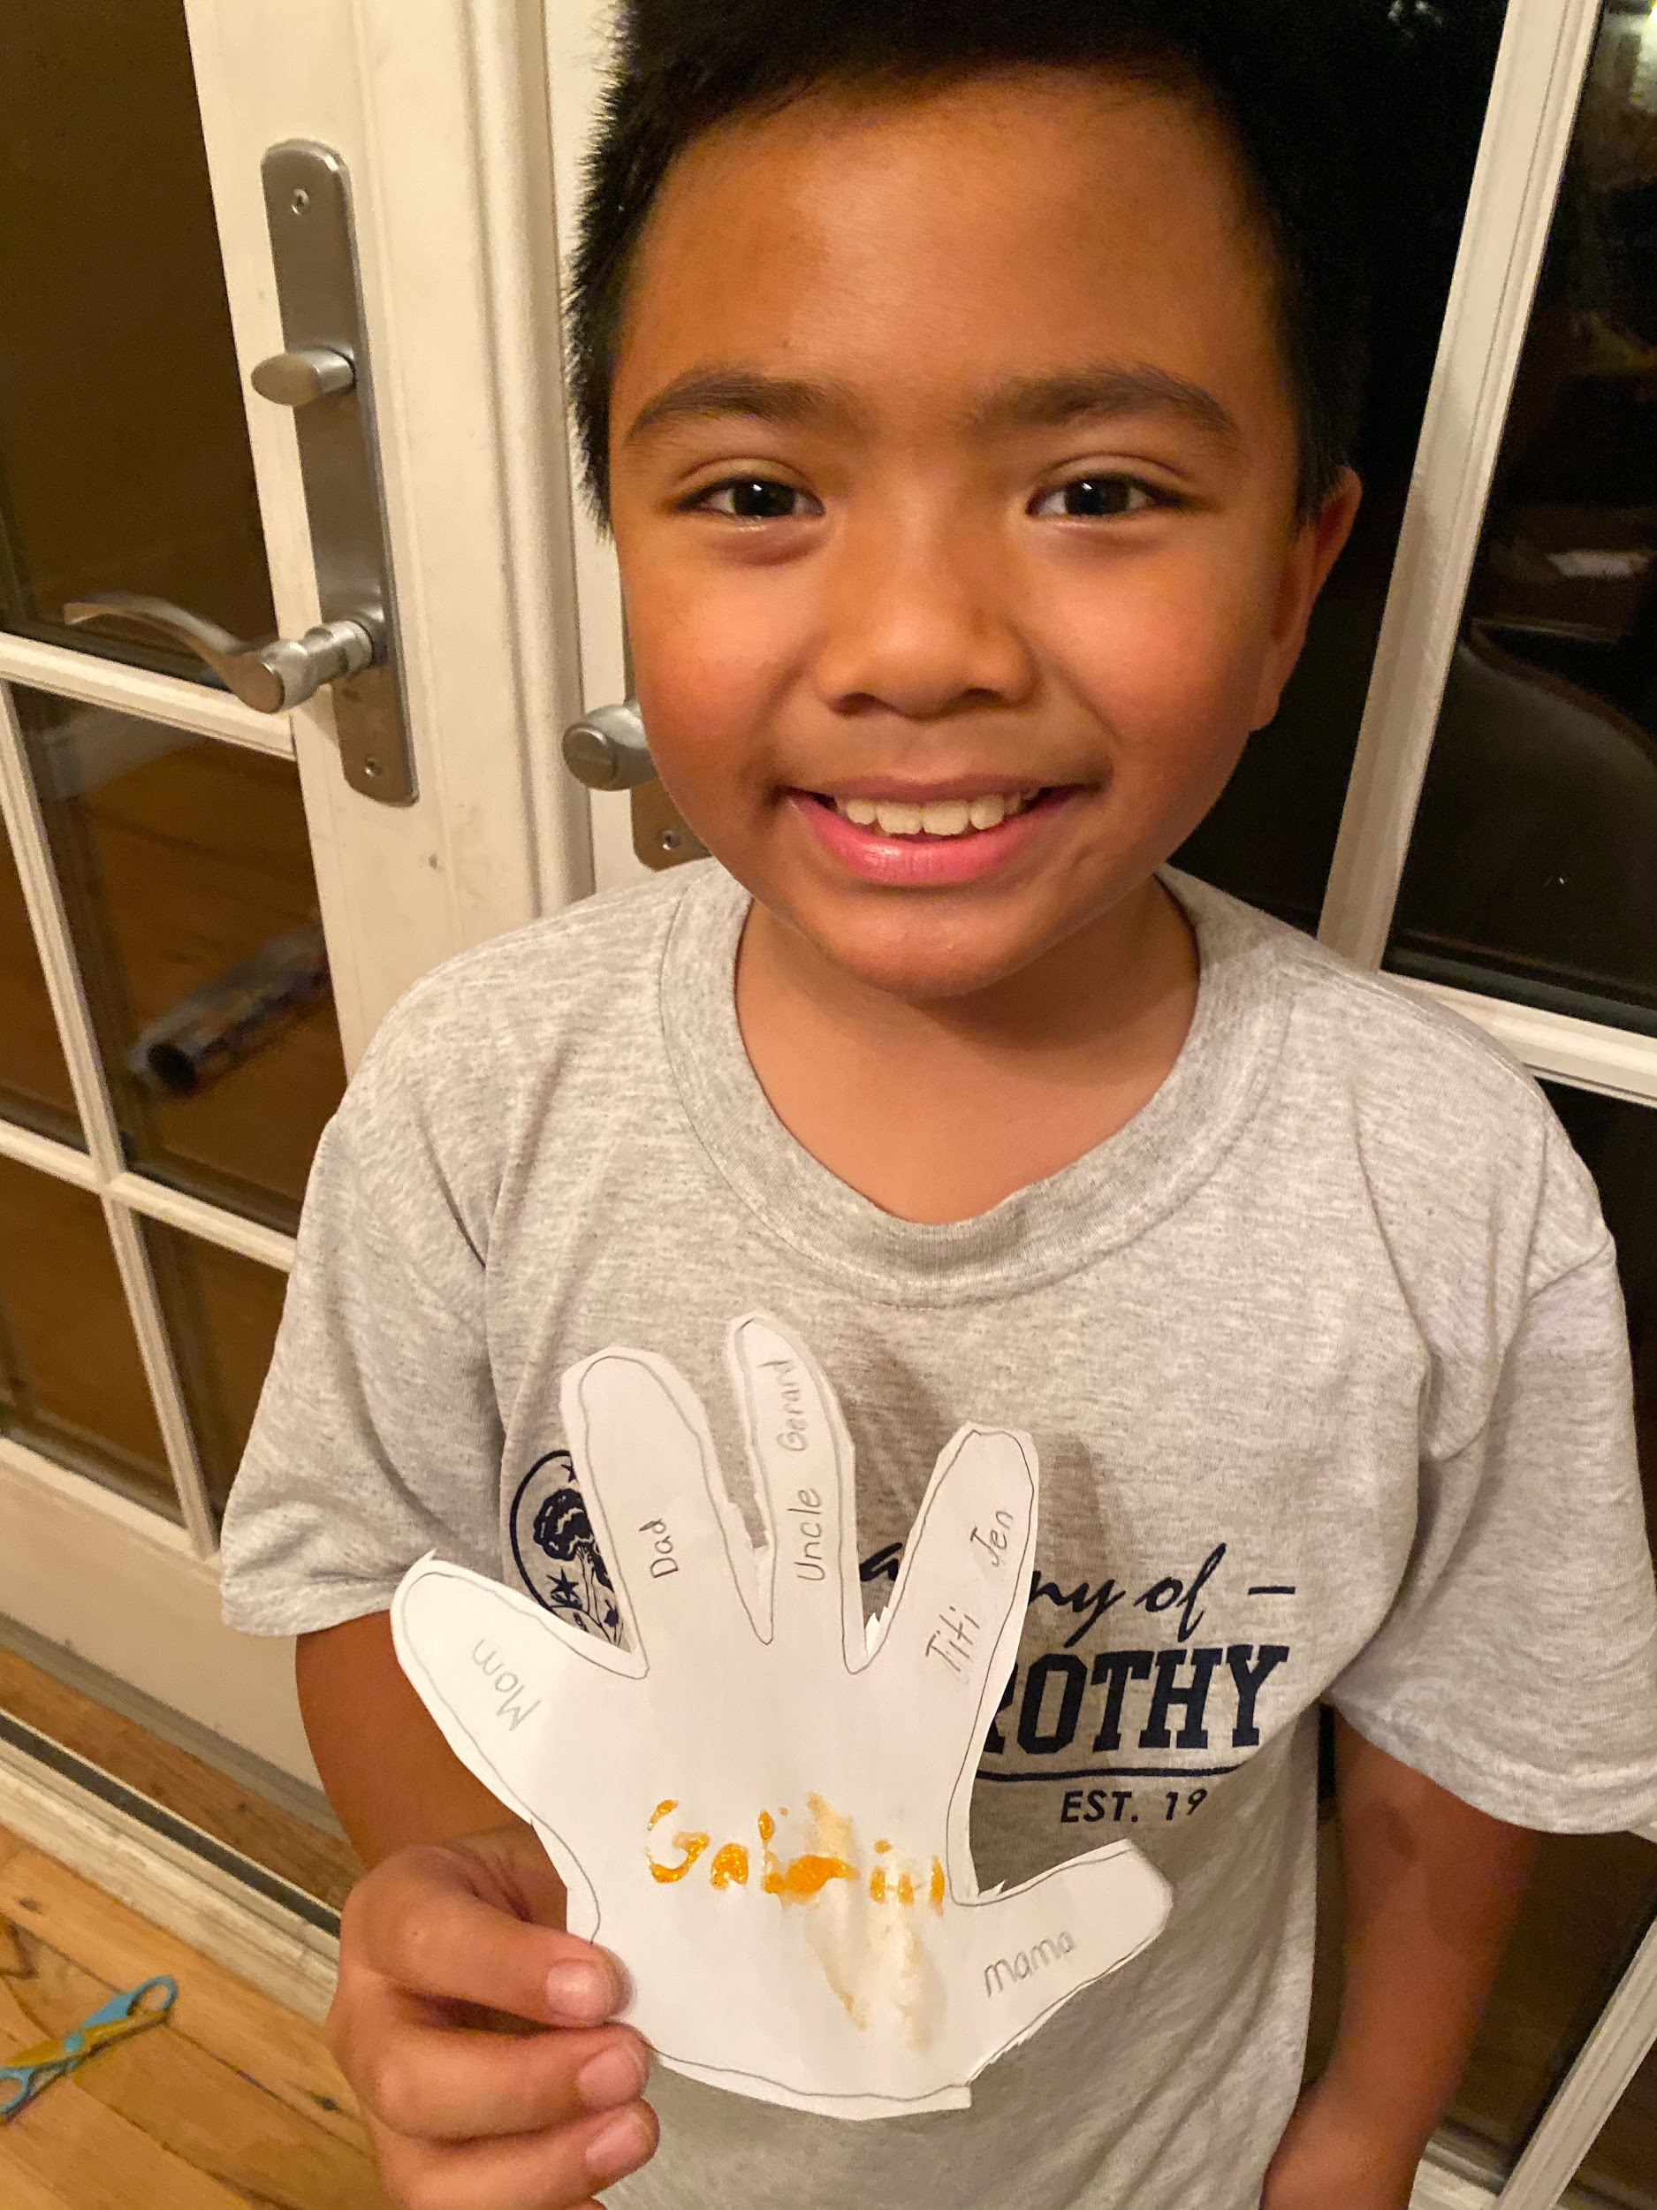

Slide 10
Parent Involvement
Higher Attendance
+ Better Grades
+ Positive School Climate
+ Parent Education
Notes:
Some schools share with me that they have a robust parental involvement. Others say it is very difficult to engage parents for a variety of reasons. Those that have shared success, say it is in part because they have broadened their definition of involvement. Engaging parents can go beyond coming to the PTA meeting, it may be sharing resources in other ways: through newsletters, emails, tech nights, family nights, information given to the student to bring home, involving parents with special talents or those that can shed light on certain challenges, such as autism, medical issues, etc. that impact behavior. And Schools with initiatives that have strong parent components are ideal.

Slide 11

Superheroes Wear Mom Jeans
Notes:
I wanted to share well researched resources and practical ways we can come together as a community and to hold that hand. Started out as a book about bullying prevention but it became a guide on leadership at both levels -- adults and children. An engaged adult is the secret weapon in teaching kids critical skills such as how to be assertive and not agressive, resilience, empahy, role modeling, how to communicate through role play and of course role modeling.

Slide 12
Most helpful adult action:
L I S T E N I N G
Notes:
We, as adults can work on certain skills.

Slide 13
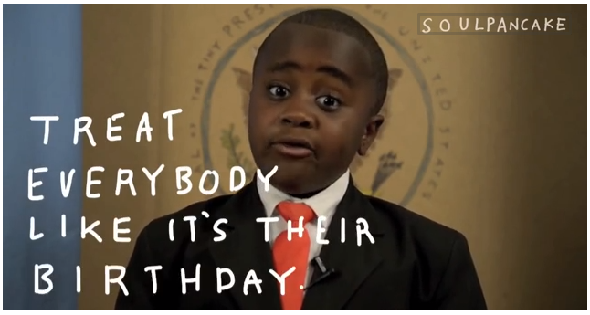
RESPECT FOR THEMSELVES & OTHERS
Notes:
Why is it so exciting to reach children at young ages?
Course correction and 2.Neuroplasticity. Lessons on assertive v. aggressive, resilience, communication and empathy. Getting down to their level and communicating in a way they can relate to. Simply put by the Kid President, Treat everybody like it’s their birthday.

Slide 14
BUILDING THE BEST
SCHOOL ENVIRONMENT

Slide 15
3 MOST POSITIVE SCHOOL VARIABLES
I feel like I’m part of this school.
I feel valued & respected at school.
I feel close to adults at my school.

Slide 16
3 MOST POSITIVE HOME VARIABLES
I can trust my parent.
I have a healthy sibling-to-sibling relationship.
My parents react well.

Slide 17
GOOD REASON to
GET PARENTS INVOLVED
1

Slide 18
KEEPING OUR KIDS PROTECTED
The NEW NEIGHBORHOOD

Slide 19
Take oxygen first.

Slide 20
CHECK IT OUT
www.tangledball.com

Slide 21
POWER OF COMMUNITY
SUPERHEROES UNITE.
WE’RE IN THIS TOGETHER.

Slide 22




CHECK IT OUT
facebook.com/tangledball
@tangledball
@susanraisch
Susan Raisch

