Slide 1
Linda Barry
General Manager Programs
Alannah & Madeline Foundation
November 2019

Slide 2
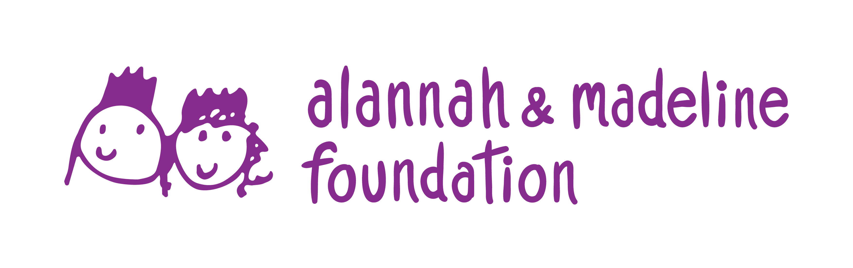
A partnership
share this! image based bullying. so not ok.
The Alannah & Madeline Foundation is one of Australia’s most respected children’s charities, and is dedicated to protecting children from violence and its devastating impact.
We care for children who have experienced or witnessed serious violence.
We reduce the incidence of bullying, cyber bullying and other cyber risks.
We advocate for the safety and wellbeing of children.
We believe that all children should have a safe and happy childhood, without being subjected to any form of violence.

Slide 3

A partnership
share this! image based bullying. so not ok.
The Supré Foundation’s dream is to foster a world where all girls can achieve their dreams, where globally this generation and future generations of girls have access to all they need to fulfil their potential.
As Supré expands internationally, the Foundation will continue to work with partners, providing a supportive environment and addressing the greatest needs in helping empower girls globally.

Slide 4
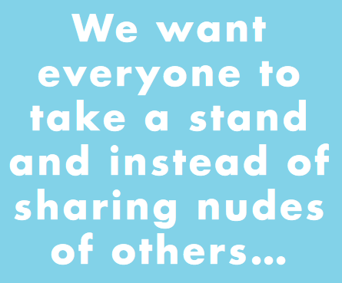
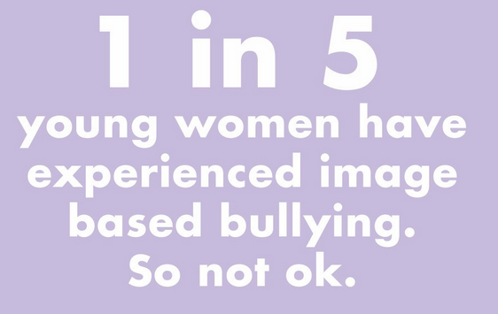

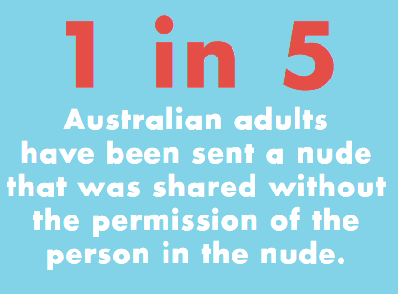
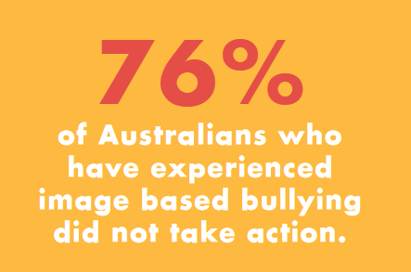
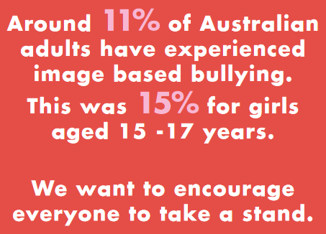
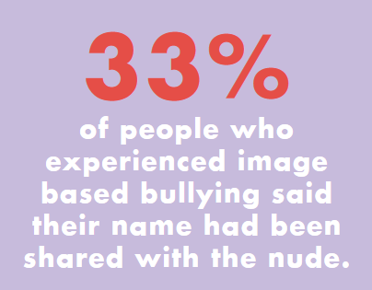
Our vision
share this! image based bullying. so not ok.
Raise awareness and change perceptions within the community relating to youth online relationships.
Promote respect and highlight social inequalities relating to gender through healthy online relationships and interactions.
Empower young people to make informed decisions.
Build young people’s resilience through education.

Slide 5


How we did it
share this! image based bullying. so not ok.
In-depth workshops in schools
We involved 14 to 16 year-olds in two separate workshops in schools, 3 to 6 months apart.
We conducted parent workshops.

Slide 6








share this! image based bullying. so not ok.
A national marketing campaign in Supré stores and their online community -
a microsite and mini booklet
‘social ambush’ using influencers including ambassadors
in-store launch event
media program
Supré store signage.
6
6

Slide 7

What worked?
share this! image based bullying. so not ok.
Co-design by young people with educators and marketers and therefore recognised where young people are at.
Not saying ‘just say no’ which does not acknowledge young people’s reality.
Run by an outside facilitator who was not a teacher (or parent). Teachers reported they tended to focus on the legal aspects because other issues were too sensitive. They were happy to leave it to someone who knows how to do that.

Slide 8
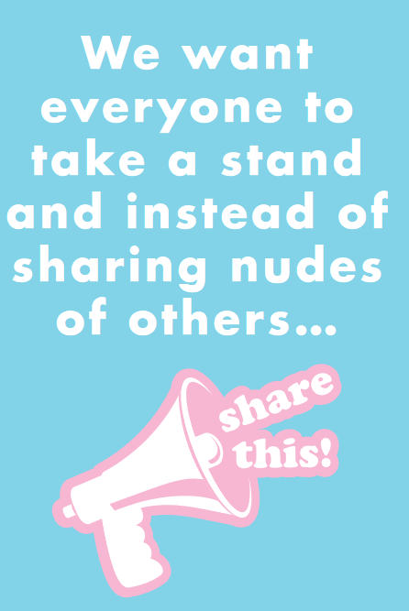
share this! image based bullying. so not ok.
A classroom discussion rather than auditorium lecture. There was power in a face-to-face deliberation that explored the issue from different angles. It forced young people into having discussions about the other people’s perspectives, which generated empathy.
Continuing and reinforcing the conversation. Facilitators reported it was the second workshop that made the most difference.

Slide 9





What next?
share this! image based bullying. so not ok.
Continuing to deliver workshops across Australia
Next phase in development between the Supré Foundation and the Alannah & Madeline Foundation – delivering to scale
Continual improvement of workshops

Slide 10
Questions???

